Slide 2
TFP Artificial Intelligence Expert Postgrade Juan Luis Trejo Medina 30th June 2020

Slide 3
Face Recognition System Using Facenet in Keras and application of Super Learner Ensembles

Slide 4
Index
Introduction
Architecture
Implementation and Budget
Conclusions

Slide 5
1.- Introduction
Challenge: Facial recognition consists in detecting identifying and verifying the faces targeted. In the face detection process the goal is to detect faces in a video and or photographs being static or dynamic motion
Objective: The objective is to develop the most efficient (considering accuracy in the probability of prediction and the computational requirement) architecture for face recognition classifier using Multilayer Convolutional Networks for face identification, Facenet in Keras which generates the embeddings and finally a comparing performances of several classifiers algorithms optimized using Stacked and Super Learner ensembles
Conclusion: It has been architected an algorithm with accuracies higher than 90% which requires low computational charge as it leverages the most efficient algorithms (State of art on each step) using pre-trained models
Applications: This can be used not only for sensible industrial infrastructures control but as well for marketing campaigns in which personalize the customer experiences when faces are recognized with this level of accuracy in stores, healthcare or security

Slide 6

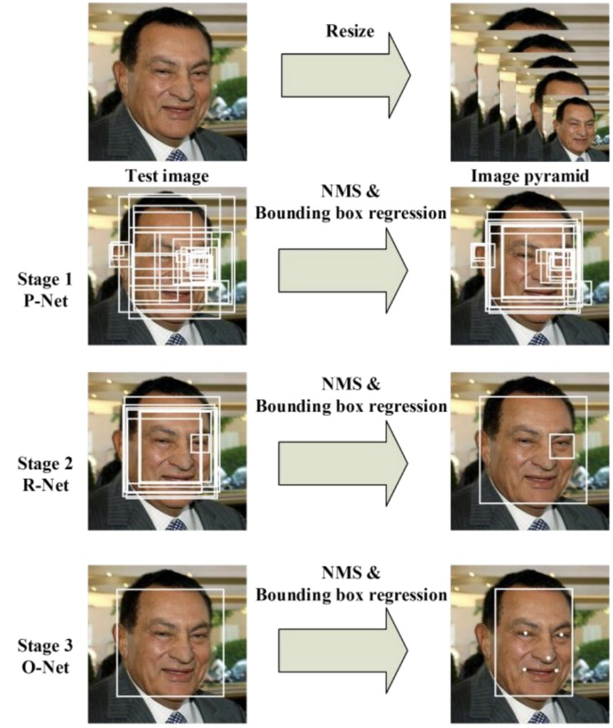
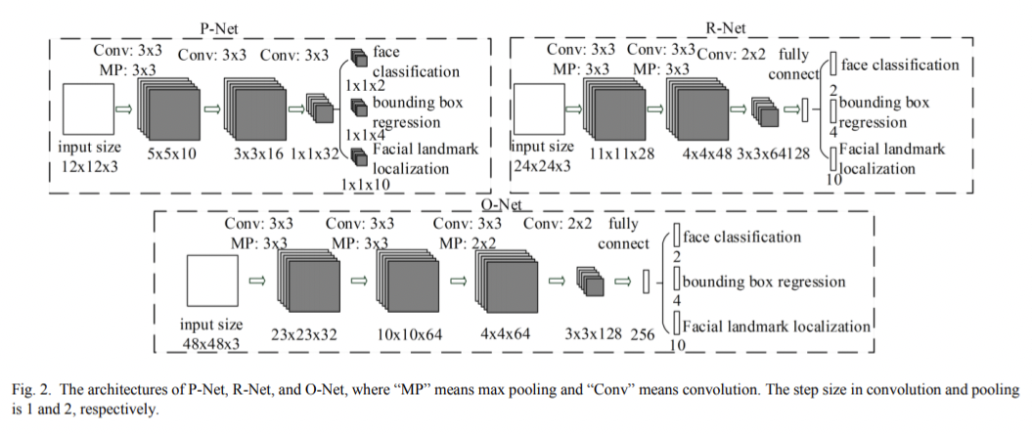
2.1- Architecture. Multilayer Convolutional Network
Three Steps:
P-Net: Looking face candidates in the picture through Bounding Box regression
R-Net: Isolating the face in the picture through finer Bounding Box regression
O-Net: Detecting 5 landmarks in the face
Fiigure source: Kaipeng Zhang, et al. in the 2016 paper titled “Joint Face Detection and Alignment Using Multitask Cascaded Convolutional Networks.” [4]

Slide 7
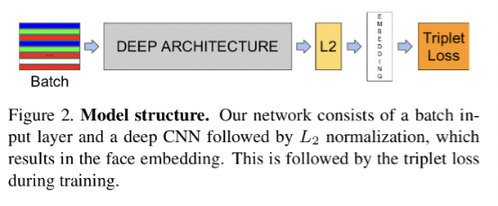
2.2- Architecture. Facenet Vectorization
Facenet Architecture
Deep Architecture shown the Convolutional Network trained
L2 is a normalization applied which provides the embeddings
Concluding with the minimization of the Loss function, Triplet Loss
Architecture used:
ML Stacked ensembles
Deep Architecture shown the Convolutional Network trained
L2 is a normalization applied which provides the embeddings
Concluding with Machine Learning Classifiers
Fiigure source: Florian Schroff, in 2015 paper tittled, “Facenet: A Unified Embedding for Face Recognition and Clustering” [5]

Slide 8
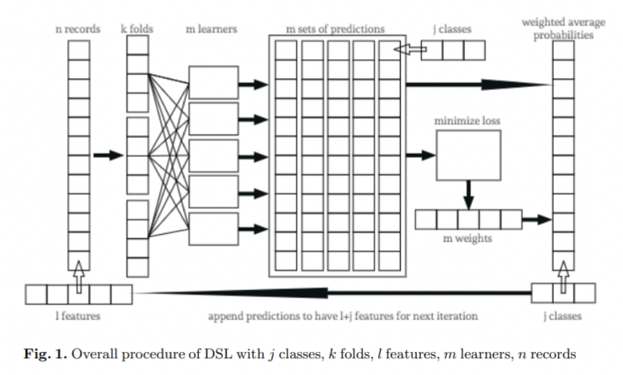
2.3- Architecture. ML Classifiers. Stacked ensembles
Stacked model Architecture
Involve more than one machine learning base models which form the Level 0 (Base model)
Models being the out-of -fold results the input of the Level 1 (Meta model) which use all the predictions of the base models to train itself.
The base models will be executed via k-fold cross validation using the same splits of the data and this dataset trains the meta model in isolation as a separate model. As an option and to provide more context the meta model can be added to the meta model training dataset the data of the base models.
Fiigure source: Steve Young, Tamer Abdou and Ayse Bener “Deep Super Learner [10]: A Deep Ensemble for Classification Problems” dated on 6th March

Slide 9
3.-Implementation and Budget
As industrial implementation this project aims to enhance the capabilities of the surveillance and access control of sensible infrastructures such as Nuclear, Power, Water plants, Refineries and Petrochemical installations
These facilities usually has installed a surveillance software with a net of CCTV which may enjoy this new enhancement upgrading just the operating Software and installing additional video cameras in the entries of the facilities
As implementation it is considered the Software of surveillance provided by Honeywell which include analytics:
• Intrusiontrace: provides high performance intrusion detection using video analytics specifically designed for 24/365 outdoor operation
• Loitertrace: provides high performance loiter detection using video analytics specifically designed for indoor/outdoor operation.

Slide 10
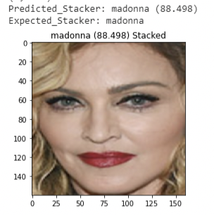
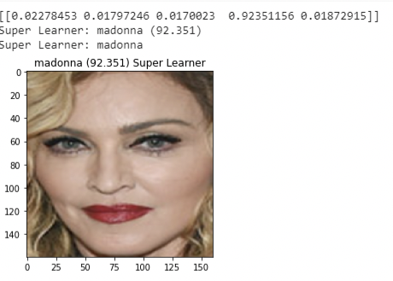
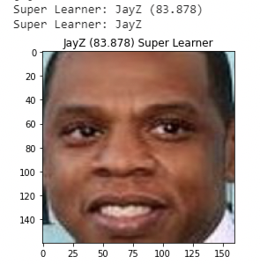
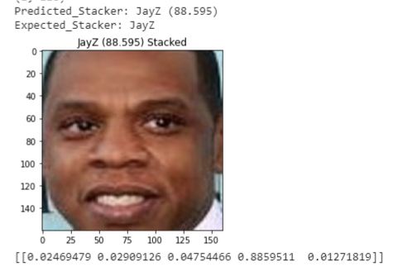
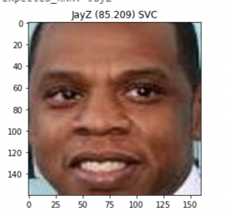
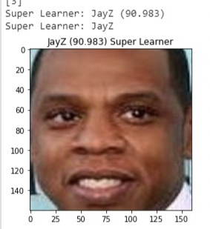
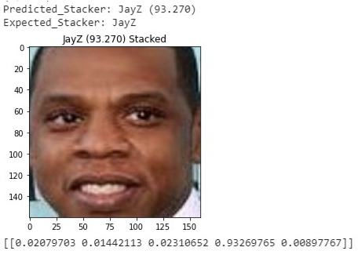
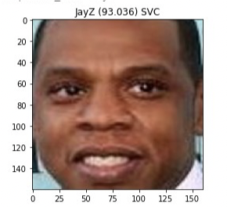
4.-Conclussions
It has been tested 3 scenarios combining real pictures and cartoon in the training datasets.
First scenario: This scenario use in both, training(15) and validation datasets Real faces of celebrities.
Conclusion: Best classifier with real faces in the training dataset is the Superlearner
Second scenario: This scenario uses in the training dataset a reduced number of cartoon pictures of celebrities (14) of different races and real faces of celebrities in the validation
Conclusion: Best classifier with real faces in the training dataset is the Stacked ensemble
Third scenario: In this scenario are trained a longer number of cartoons images (35) and still one real image in the validation dataset
Conclusion: Best classifier with real faces in the training dataset is the Stacked ensemble

Slide 11
4.-Training data
It has been tested 3 scenarios combining real pictures and cartoon in the training datasets.
Ben Affleck
Elton John
First scenario: Training with real faces
Second scenario: Training with reduced number of cartoons
Third scenario: Training with larger number of cartoons
Beyonce
Obama
Dalai Lama

Slide 12
Final conclussions
We can conclude that executing the classification with machine learning models is computationally more efficient than executing the classification through the triple lost research in the Euclidean space generated in the Facenet algorithm. The most efficient one when used real faces in the training dataset is the Superlearner model being a better fit either the stacked ensemble or the Linear Support Vectorial Classifier model when the training dataset has low quality pictures.
In all the cases we can get probabilities higher than 90% with 14 real pictures with a Superlearner classifier or either SVC or Stacked Ensemble if we use 14 cartoon or low quality pictures

